Slide 1
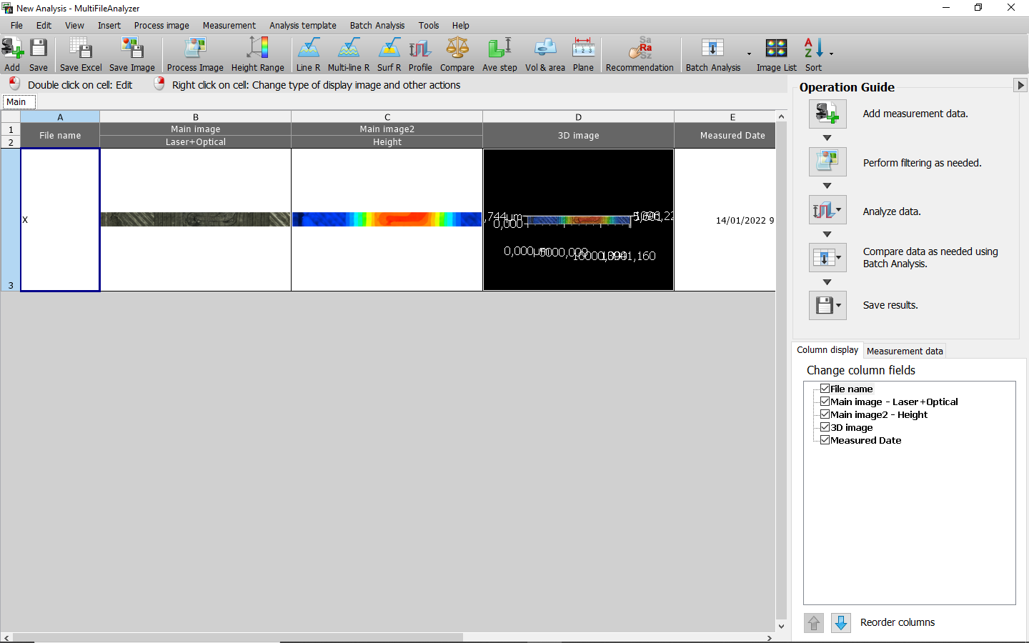
Data Extraction
If MultiFileAnalyzer is not available, the process can be completed on VK Analyzer. Use the Profile tool to select all the desired height data; click on File, Output CSV file; open CSV file and scroll down to find the Height data.
Open file with MultiFileAnalyzer

Slide 2
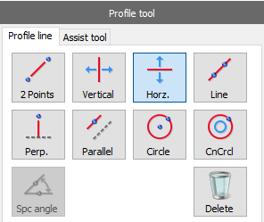
Data Extraction
Select the “Profile” tool.
If processing a measurement along the X axis, use the “Horizontal” profile line.
If processing a measurement along the Y axis, use the “Vertical” profile line.
These lines should allow to extract data with the proper alignment, thanks to the alignment operation performed during measurement.

Slide 3
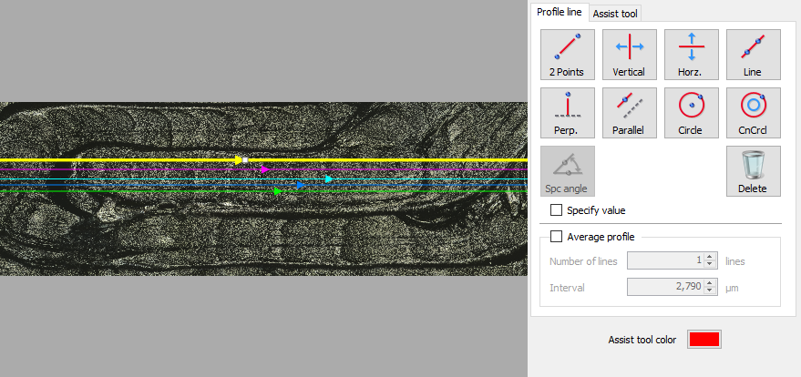
Data Extraction
Place as many profile lines on the sample data as desired, making sure that they all include all the features of interest (they need to pass over the top step of the pyramid).

Slide 4
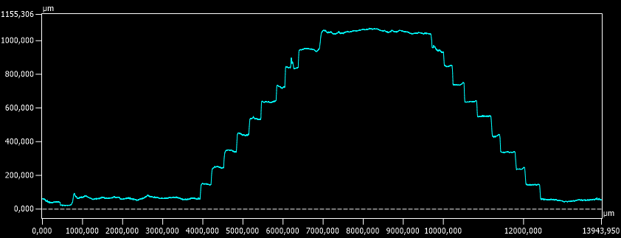
Data Extraction
Choose profiles that show somewhat reasonable shapes (try to avoid excessive deviations/defects that are not representative).
This is perfect – a bit noisier is handleable too

Slide 5
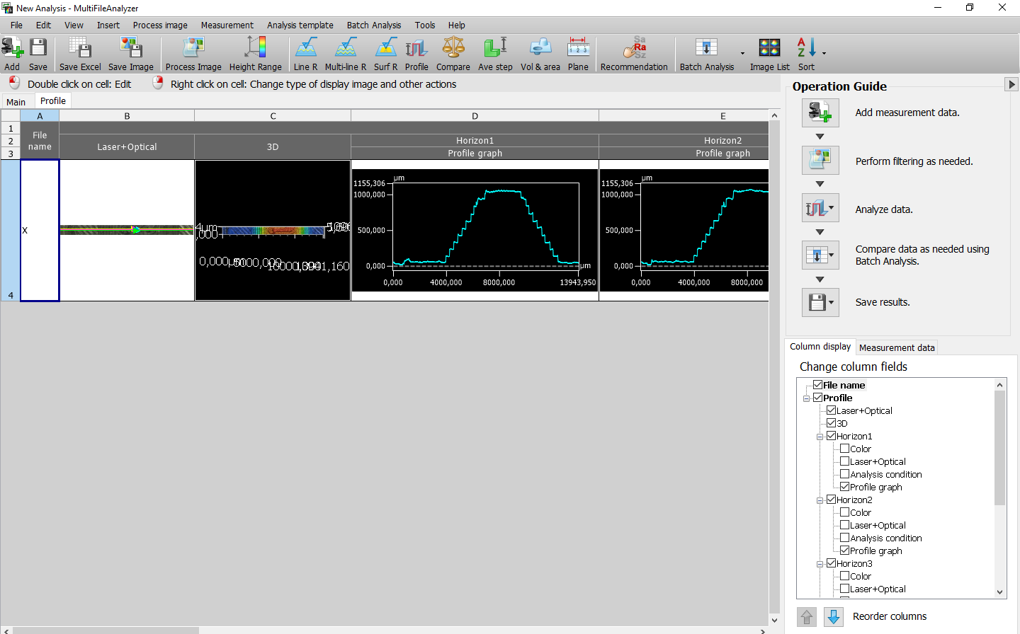
Data Extraction
Once you have drawn all the profile lines you want to extract, click “OK”.
Back to the main Analyzer window, the profiles have been added to the right of the previously shown images.

Slide 6
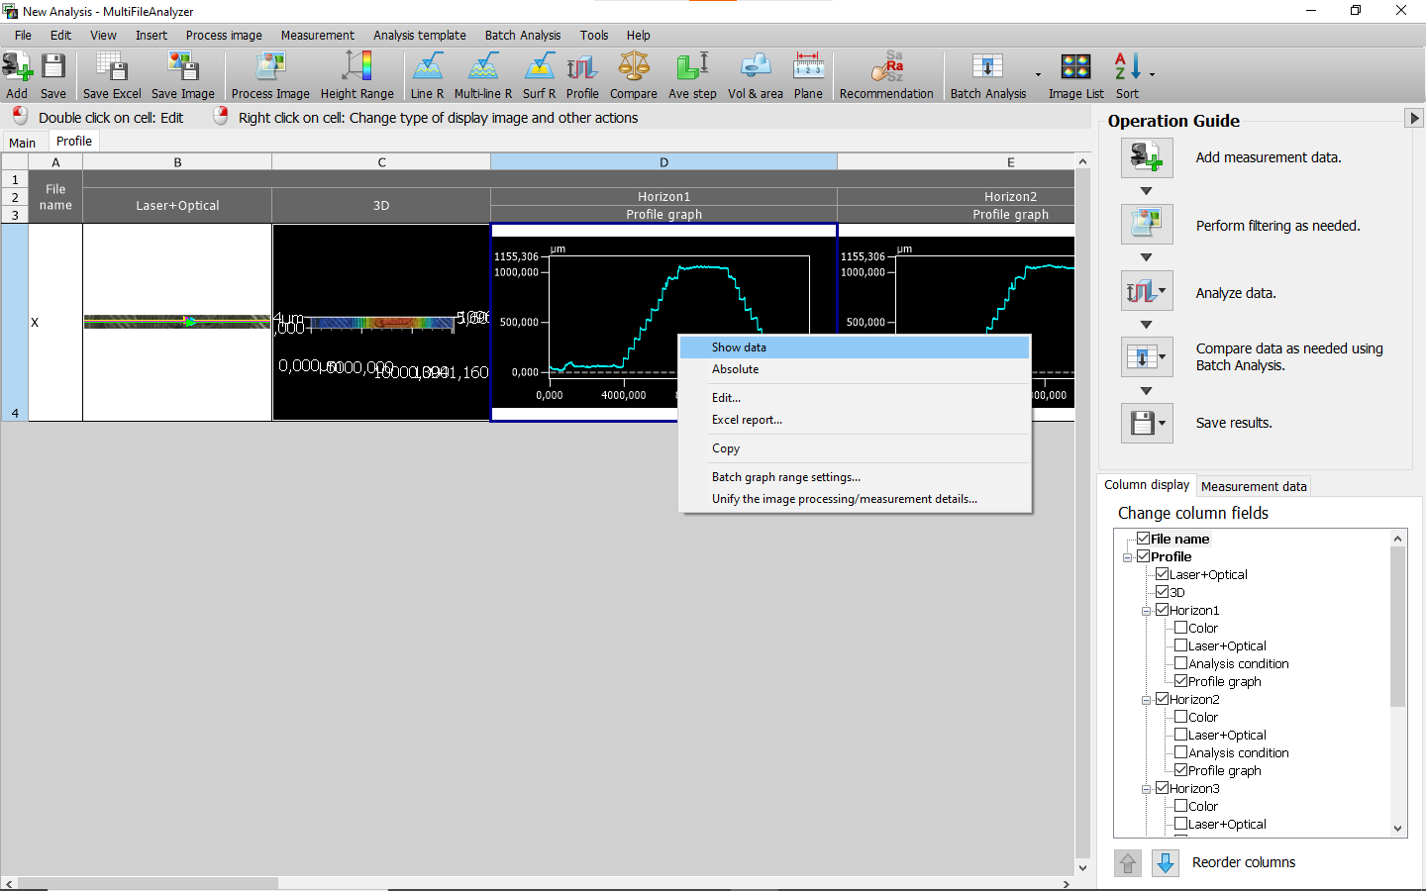
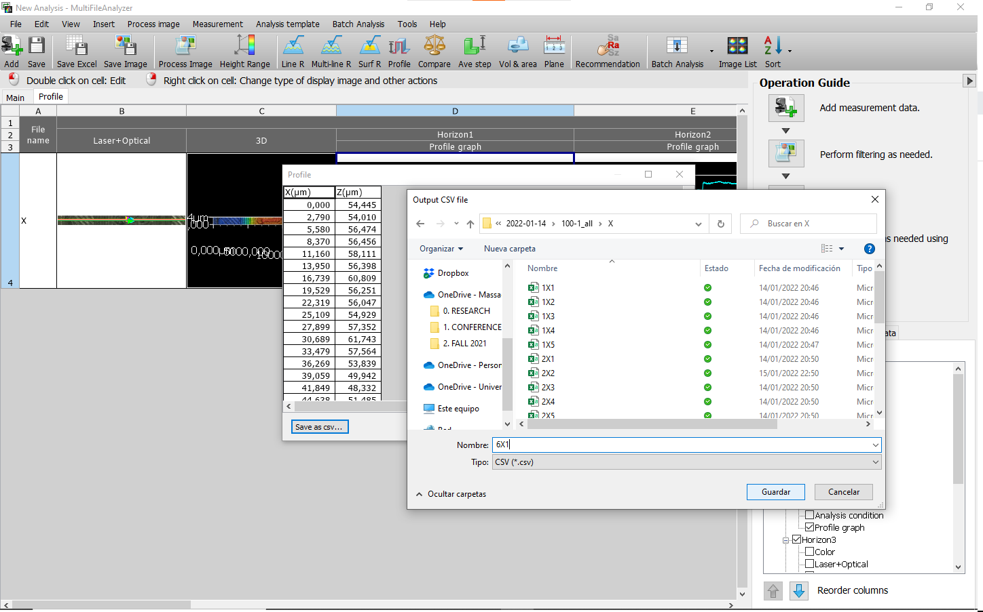
Data Extraction
For each profile graph, right click on the image and select “Show data”.
Click on “Save as csv…” and save the data in the desired folder.

Slide 7
Data Extraction
Save all the comparable data in the same folder, separated from that of other dimensions/structures.
Fore example, have these separate folders:
Layer height 100 um, 1 layer per step, X
Layer height 100 um, 1 layer per step, Y
Layer height 100 um, 3 layers per step, X
Layer height 100 um, 3 layers per step, Y

